Slide 1
Telford & Wrekin
SENDIASS
Information Advice and Support Service

Slide 2
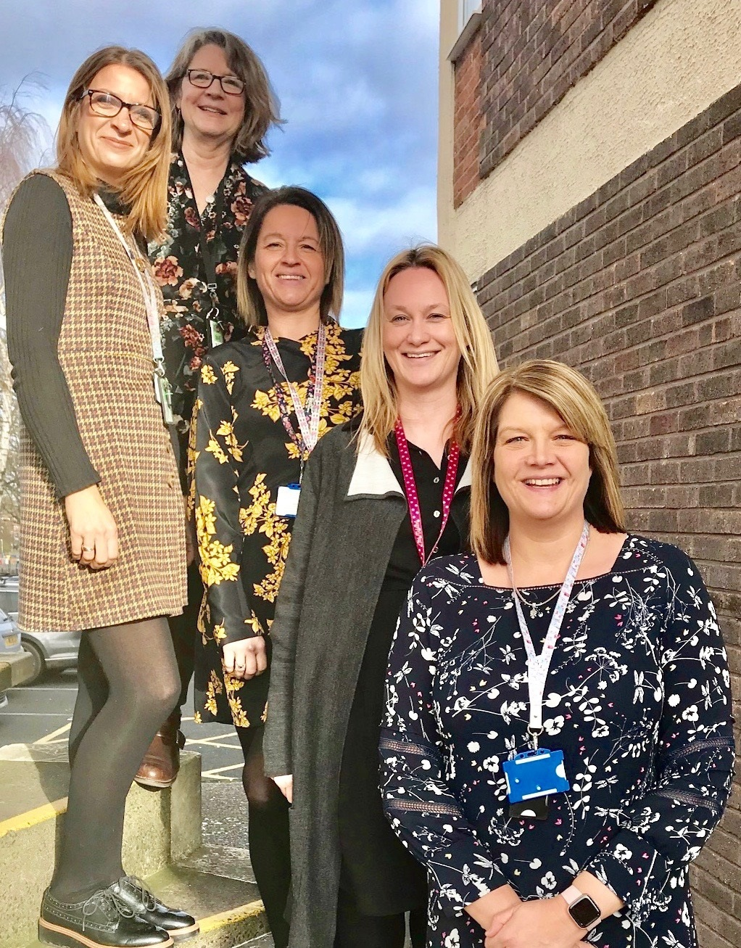
Meet the Team

Slide 3
Telford and Wrekin
SENDIASS
SENDIASS service offer
Tier levels
Tier 1 Universal Offer
Tier 2 SEN Support
Tier 3 EHCP’s
Tier 4 Mediation Tribunals DDA and Complaints to Ombudsman

Slide 4
One page profiles
A One Page Profile is a summary of what we like and admire about our children and young people and how best to support them.
What matters to them…
Be specific – who, what and when

Slide 5
Qualities
What people like and admire about me?
This section lists the positive ’proud’ qualities, strengths and talents of the child or young person
What do people admire about your child
Information from others - Class friends and Parent/Carers. Family members, Nan, Grandad, Cousins Aunt and Uncles, Close friends
Strengths
Kind and caring
Good friend

Slide 6
What is important to the young person…
List of what really matters to the young person from their perspective (even if others do not agree)
Who is important in my life
Important activities and hobbies at home and school
Any routines which are important to the young person.
Places that are important
Music, food and drink, TV that are important
Favourite lessons and break time activities

Slide 7
How best to support me…
Share those tips that we know work.
Specific information that would be useful for other people to know about the child/young person so they get the best support possible.
What is helpful and what is not. It can include specific triggers and how to avoid or manage them.

Slide 8
Example of a one page profile

Slide 9
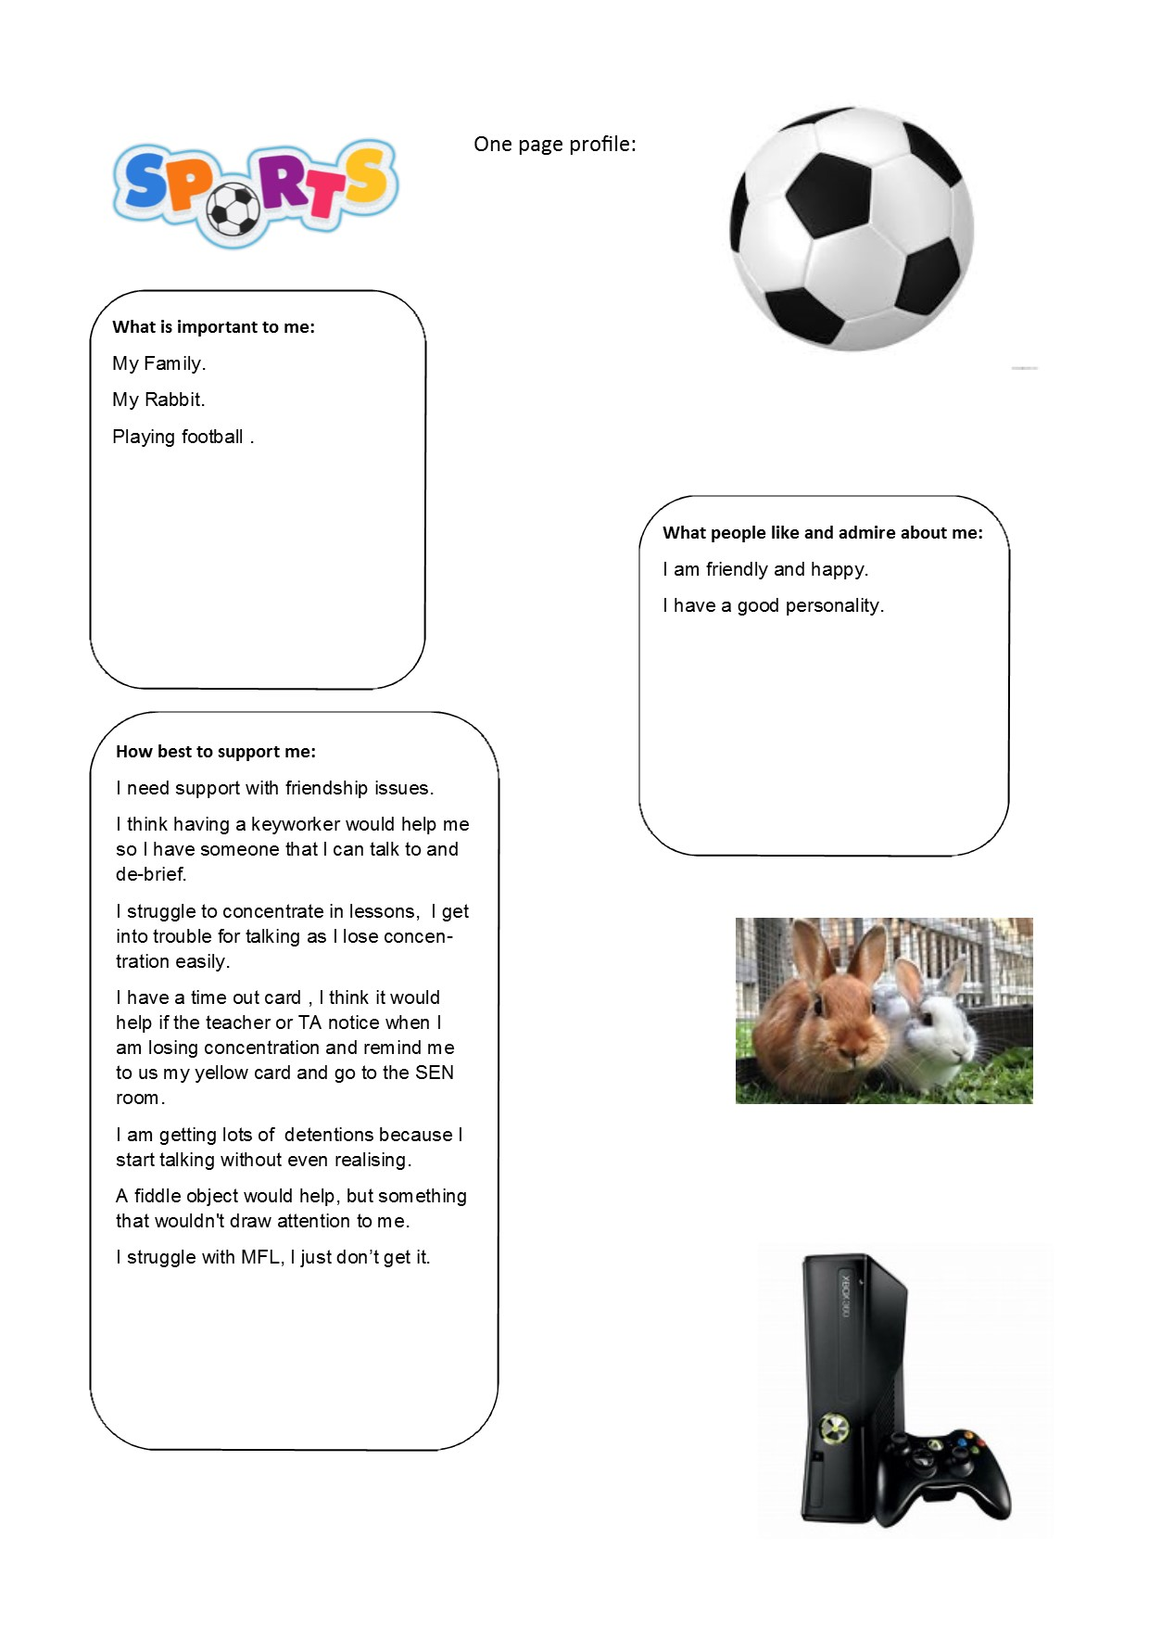
One page profile
Notes:
Day to day responsibility for the SEN policy, coordinating of specific provision for children with SEN including those with EHCP’s.
SENCO’s qualifications
Advising and supporting colleagues around SEN
Advising on the Graduated Approach
Ensuring parents/children and young people are closely involved throughout and that their views are valued
Liaising with professionals/external agencies
The role of class teacher
School and Parents to monitor progress and interventions
Make decisions on any changes needed to support outcomes in consultation with parents and pupil.
External professionals may need to be involved with these reviews.
Localised information
Alternative provisions
Fair Access Panel
Schools Inclusive Forum

Slide 10
https://www.telfordsendiass.org.uk/
IASS Referral line 01952 457176
Email: info@iass.org.uk
https://www.podstelford.org/
https://www.telfordsend.org.uk/site/index.php
Notes:
Day to day responsibility for the SEN policy, coordinating of specific provision for children with SEN including those with EHCP’s.
SENCO’s qualifications
Advising and supporting colleagues around SEN
Advising on the Graduated Approach
Ensuring parents/children and young people are closely involved throughout and that their views are valued
Liaising with professionals/external agencies
The role of class teacher
School and Parents to monitor progress and interventions
Make decisions on any changes needed to support outcomes in consultation with parents and pupil.
External professionals may need to be involved with these reviews.
Localised information
Alternative provisions
Fair Access Panel
Schools Inclusive Forum

